Slide 1
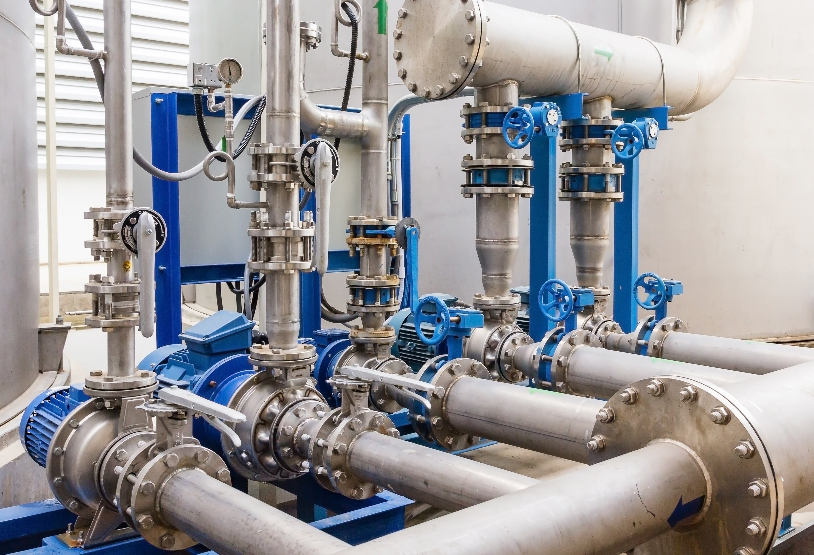





SIH
2023
ADDRESSING
NRW
USING DIGITAL TECHNOLOGY

Slide 2

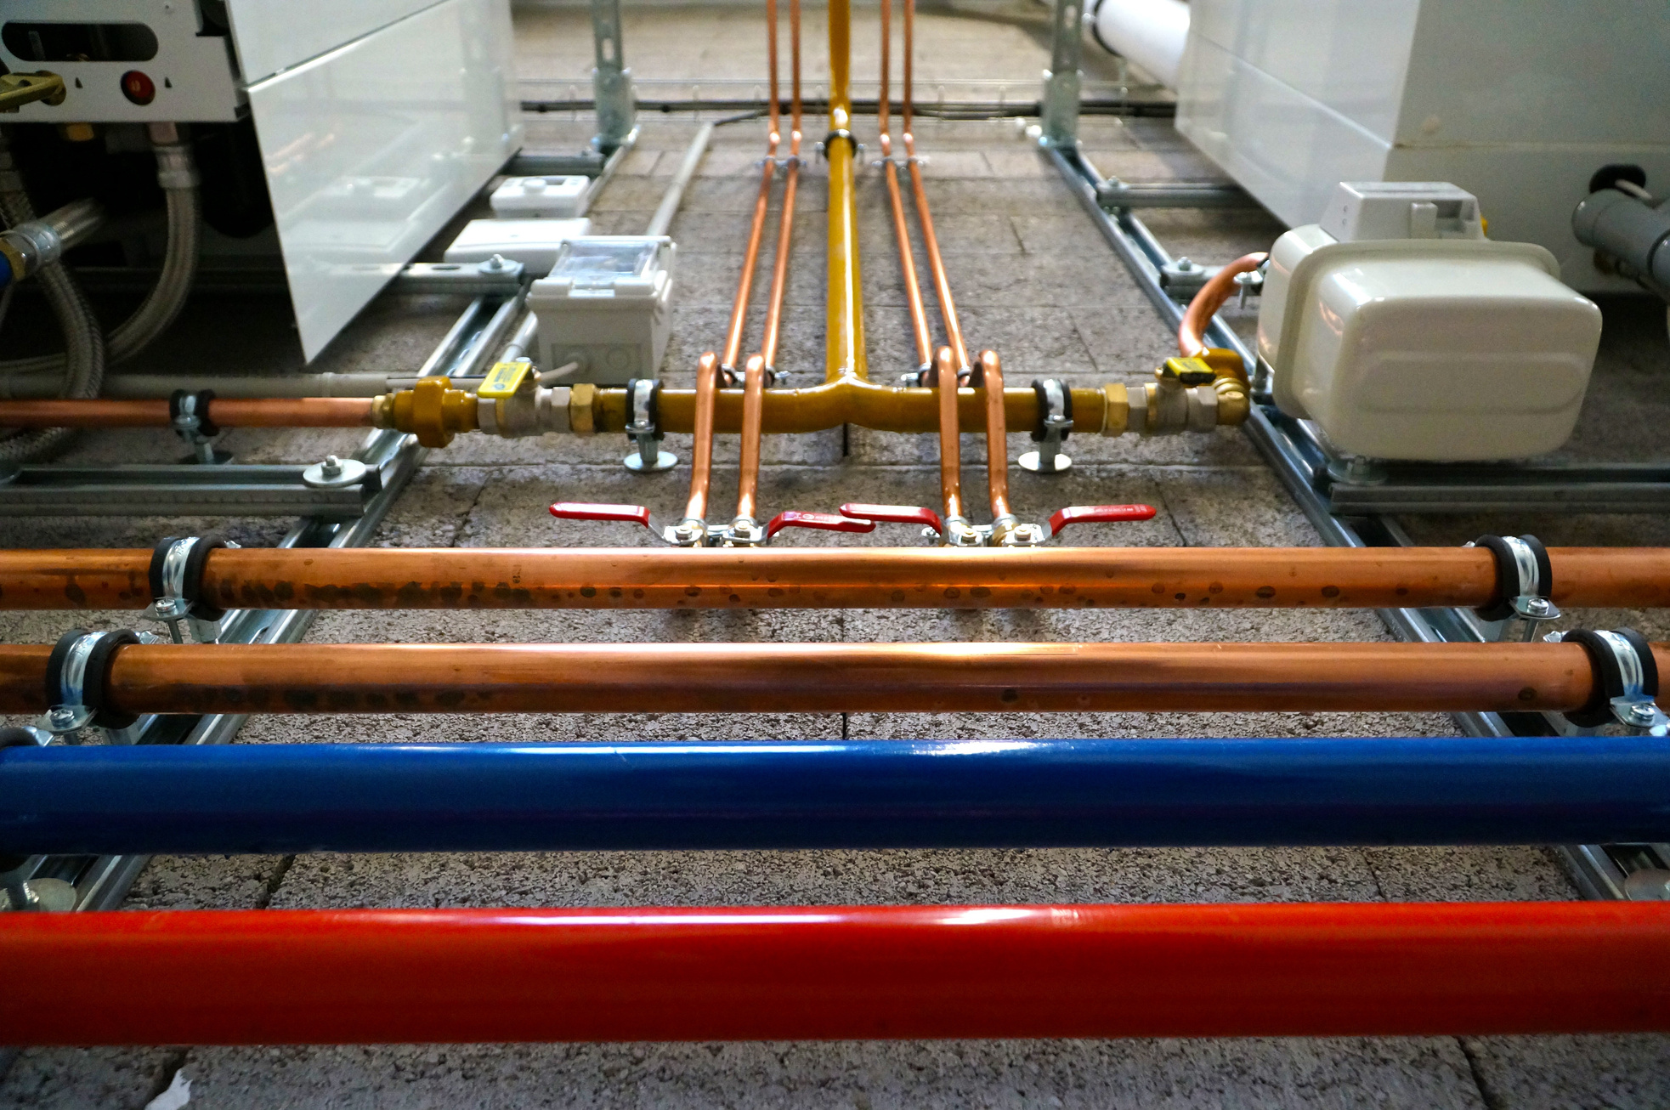
DETAILS
Ministry :Ministry of Jal Shakti
PS Code : SIH1288
Problem Statement Title : Use of Digital Technology in addressing Non-Revenue Water (NRW)
Team Name : Innovators United-KPR
Team Leader Name : Ravindran LogaSanjeev
Institute Code (AISHE) : C-36999
Institute Name : KPR Institute of Engineering And Technology
Theme Name : Clean & Green Technology

Slide 3


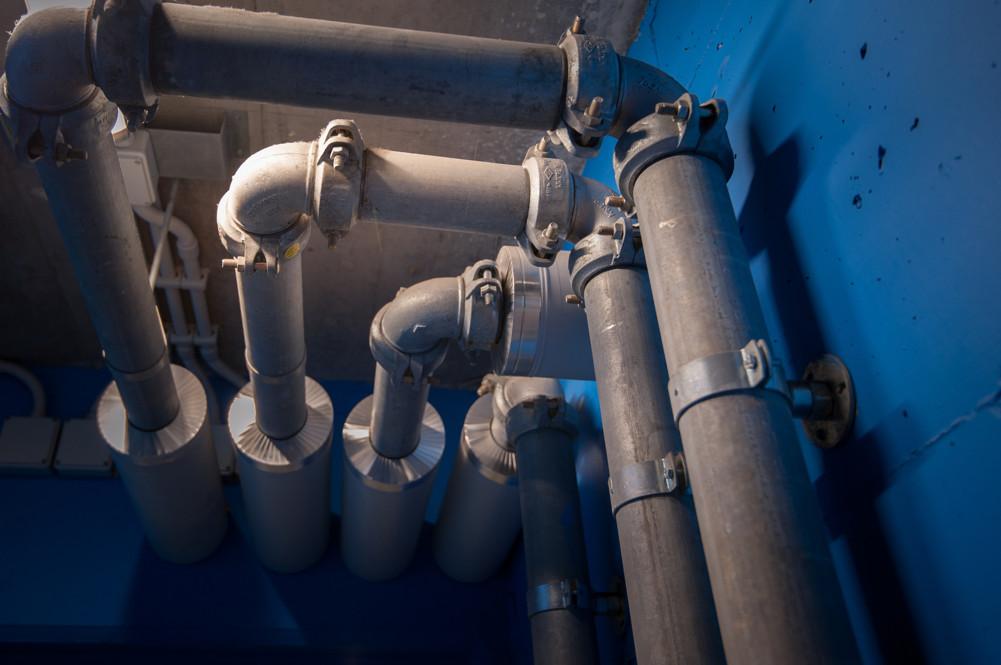

IDEA/APPROACH DETAILS:
An intelligent water flow monitoring system for pipelines
NRW detection software: analyzes data to identify Non-Revenue Water (NRW) occurrences and areas of concern in water distribution systems.
Software swiftly detects water theft and leaks, triggering immediate actions to prevent revenue loss.

Slide 4
TIMELINE
01
02
03
04
05
MONITORING
DATABASE
AI
DASHBOARD
REPORTING
The water flow sensors constantly measures water flow in pipelines and uploads all the data into a database situated in a cloud enviroinment
The database collects
sensor readings at a high pace and stores the data and also calculates total water lost
A well trained AI that is specifically trained to detect leak/theft constantly monitors the flow rate and generates a result/prediction if any anomaly is detected
A neat dashborad is generated which is easily understandable by anyone and provides the entire report in a brief yet complete way
The so far obtained answer of the ai and the link to the dashboard is sent to concerned authorities either via sms or email

Slide 5
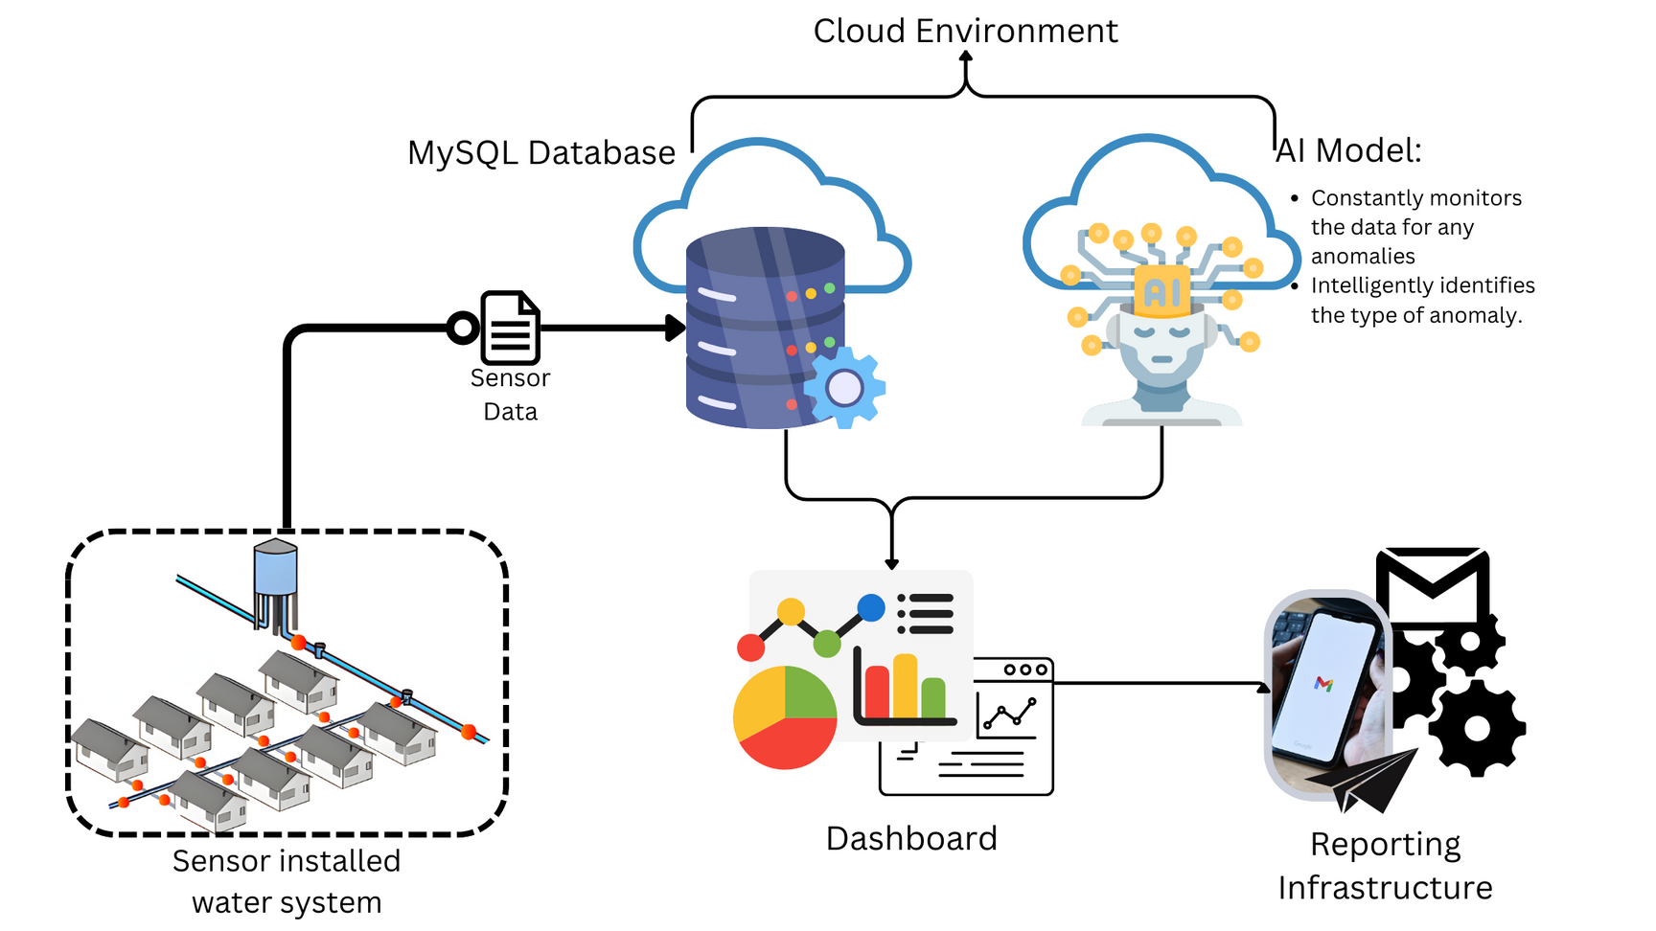
FLOW CHART

Slide 6





ARTIFICIAL INTELIGENCE
Observation
Segregation
Prediction/Answer
Excellence
In case if any anomaly is found then the anomaly will be segregated into different types of leaks/theft
The specific type of anomaly will be predicted and given to the dashboard for the user to see
The AI is very well trained. almost 4000000 records are fed to train the AI. So the given answer is ery well reliable
The AI constantly oberves the database for any anomaly

Slide 7
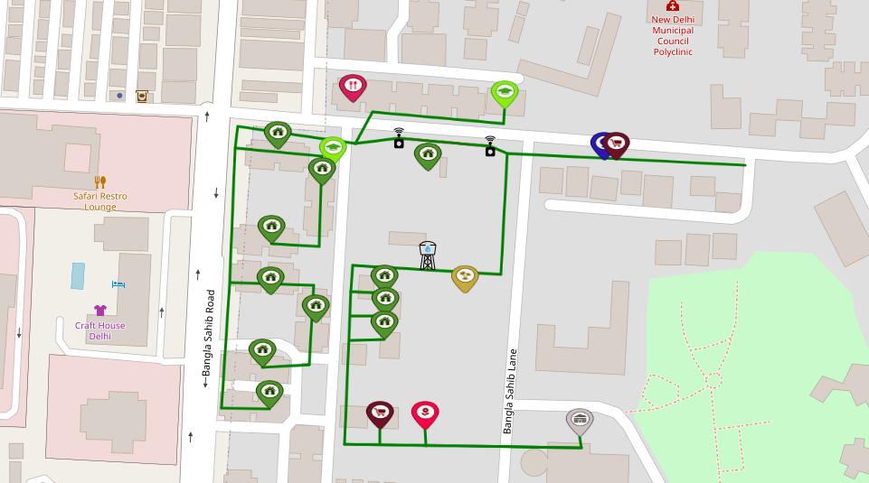
SENSOR INSTALLED ENVIROINTMENT

Slide 8
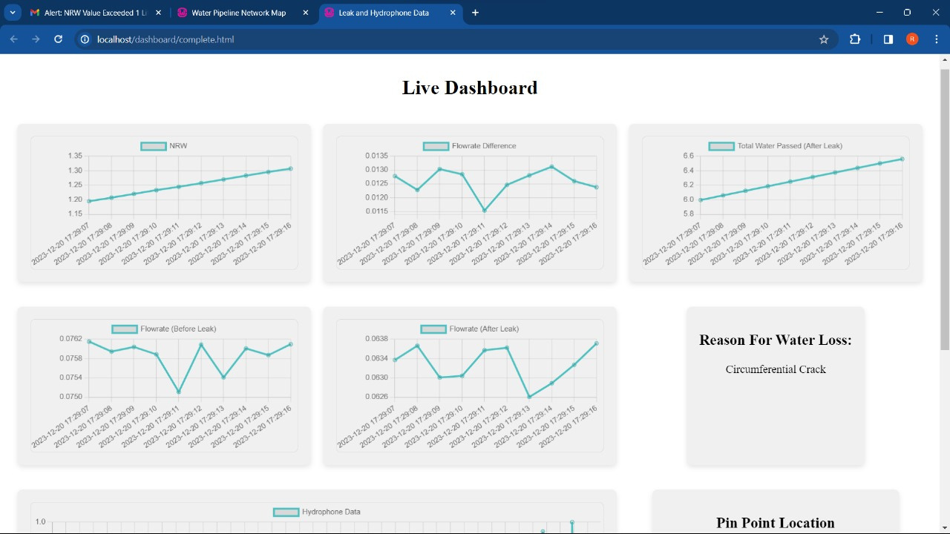
DASHBOARD (WATER LEAK)

Slide 9
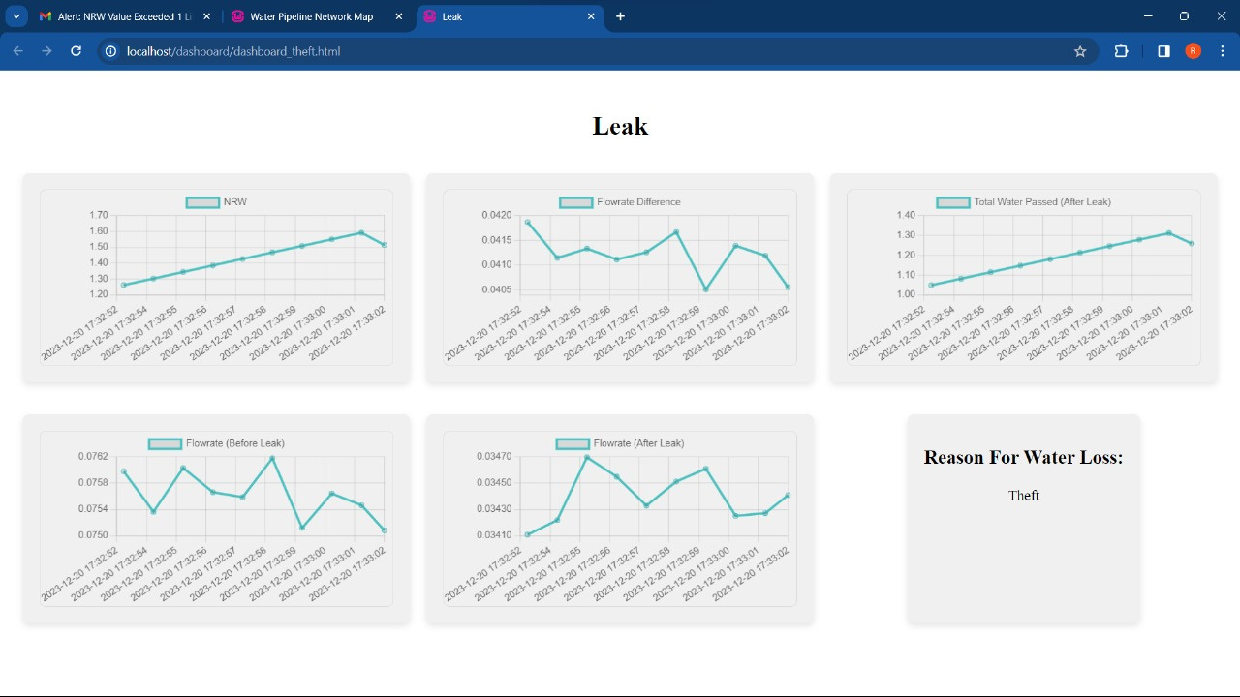
DASHBOARD (THEFT)

Slide 10




REPORTING INFRASTRUCTURE
Alert message
Checking
Complete
The information is sent either by SMS or by Gmail. And wil be given the link to the dashboard
Checking if the issue is been solved or not
The issue is solved and verified successfully
Dashboard
Waiting
The complete dashboard is sent to the concerned authorities
Waiting for a reply from the concern authorities

Slide 11
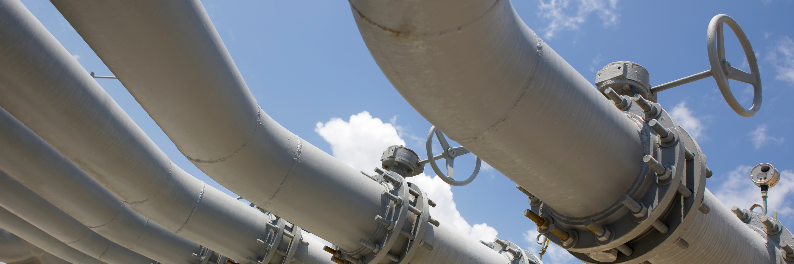

POINTS TO BE MODIFIED
1.TYPES OF LEAKS IN SMS/EMAIL
2.PINPOINT LOCATION IN DASHBOARD
3.PRODUCT PROFIT
4.BUDGET
5.VERIFICATION OF FINAL WORK

Slide 12
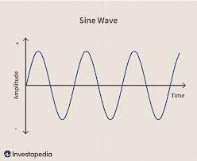
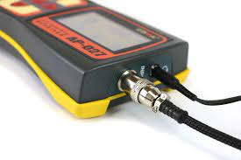
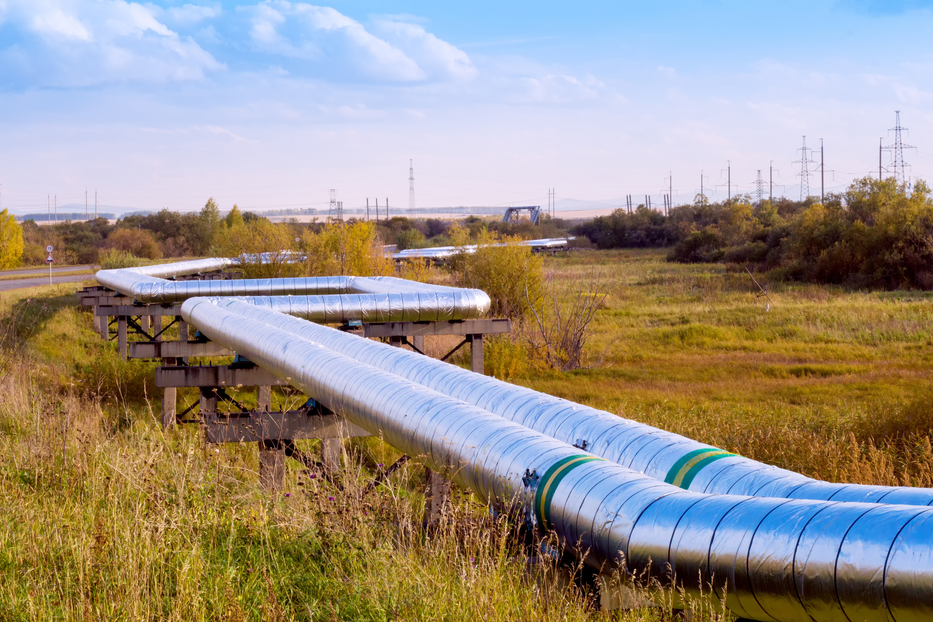

HYDROPHONIC SENSORS
Hydrophonic sensors are used to calculate the distance of crack from the the sensor this helps to find the crack easily and efficiently
1.
2
High accuracy
Cost efficient
The exact location of the crack can be found with little to no deviation. Also it has higher range than acoustic sensors
Hydrophones are cheap compared to acoustic sensors and does not need too many sensors within a given area

Slide 13
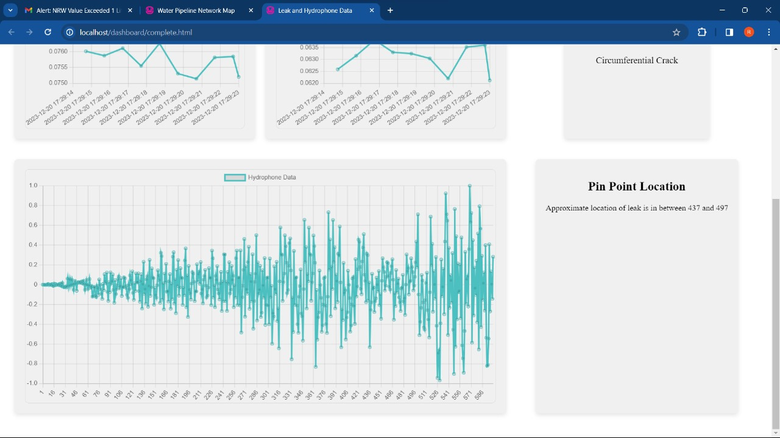
DASHBOARD (HYDROPHONE)

Slide 14



BUDGET
01
Water flow sensor : ₹425
NODEMCU : ₹150
Hydrophonic sensor: ₹7000
02
By installing these above hardwares we get an average of ₹20000 per 0.01 sqr km.
And ₹2000000 per 1 sqr km
03
With maintainence and install cost we get an average of cost of installing in a big city like coimbatore is approximately
60 crores

Slide 15
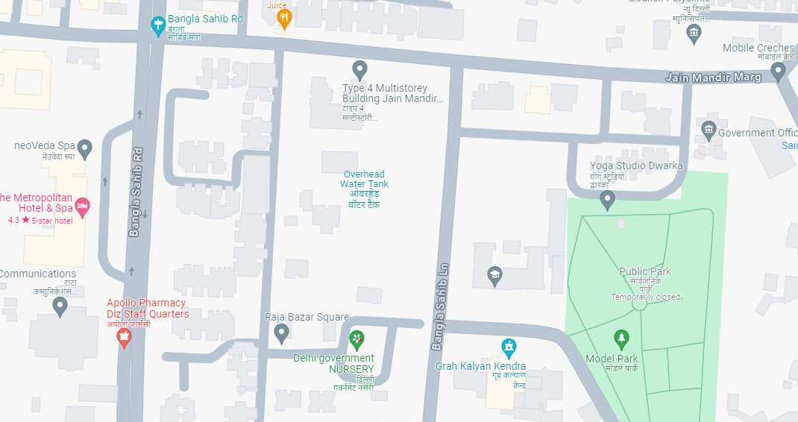




Slide 16
Certainly, let's calculate the total hardware cost for the given components where the number of water flow sensors (SEN-HZG1WA) is 9. Given the individual costs:
Unit Cost of each Water Flow Sensor (SEN-HZG1WA) = ₹425
Unit Cost of NODEMCU ESP8266 = ₹157
Unit Cost of Ambient Recording BC20 Case = ₹6990
The mathematical formula for calculating the total hardware cost is:
Total Hardware Cost=∑(Unit Cost of each Sensor × Number of Sensors)
Substitute the values:
Total Hardware Cost=(₹425 ×9)+(₹157×9)+(₹6990×4)
Now calculate the total:
Total Hardware Cost=₹3825+₹1413+₹27960
Total Hardware Cost=₹33198
Therefore, the total hardware cost for 4 water flow sensors (SEN-HZG1WA), 4 NODEMCU ESP8266, and 1 Ambient Recording BC20 Case is ₹33198.

Slide 17
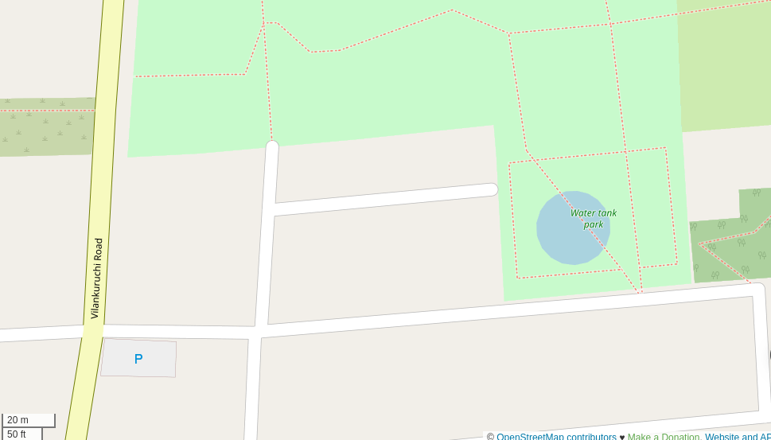




Slide 18
Certainly, let's calculate the total hardware cost for the given components where the number of water flow sensors (SEN-HZG1WA) is 2. Given the individual costs:
Unit Cost of each Water Flow Sensor (SEN-HZG1WA) = ₹425
Unit Cost of NODEMCU ESP8266 = ₹157
Unit Cost of Ambient Recording BC20 Case = ₹6990
The mathematical formula for calculating the total hardware cost is:
Total Hardware Cost=∑(Unit Cost of each Sensor × Number of Sensors)
Substitute the values:
Total Hardware Cost=(₹425 ×2)+(₹157×2)+(₹6990×1)
Now calculate the total:
Total Hardware Cost=₹850+₹314+₹6990
Total Hardware Cost=₹8154
Therefore, the total hardware cost for 4 water flow sensors (SEN-HZG1WA), 4 NODEMCU ESP8266, and 1 Ambient Recording BC20 Case is ₹8154.

Slide 19
To calculate the average hardware cost between the worst case (₹33,198) and the best case (₹8,154), you can use the formula:
Average Hardware Cost =(Worst Case Cost +Best Case Cost)/2
Substitute the given values:
Average Hardware Cost= (₹33,198+₹8,154)/2
Calculate the average:
Average Hardware Cost= ₹41,352/2
Average Hardware Cost=₹20,676

Slide 20
Given rate for 0.01 km²: ₹20,676
Hardware Cost for 1 km²=Given Rate for 0.01 km²× (0.01)/1
Hardware Cost for 1 km²=₹20,676×100
Hardware Cost for 1 km²=₹2,067,600
Hardware Cost for Coimbatore (246.8 km²):
Using the same rate:
Hardware Cost for Coimbatore=Hardware Cost for 1 km²×Area of Coimbatore
Hardware Cost for Coimbatore=₹2,067,600×246.8
Hardware Cost for Coimbatore=₹51,02,83,680

Slide 21
REFERENCES
Ali M Sadeghioon et al 2014 Smart Pipes: Smart Wireless Sensor Networks for Leak Detection in Water Pipelines J. Sens. Actuator Netw. 3 pp 64-78.
Jayalakshmi M and Gomathi V 2015 An Enhanced Underground Pipeline Water Leakage Monitoring and Detection System Using Wireless Sensor Network Int. Conf. on Soft-Computing and Networks Security pp 1-6.

Slide 22
Team Member Details
Team Leader Name: Ravindran LogaSanjeev
Branch : B.E Stream : CSE Year : II
Team Member 1 Name: Raam Prashath .T
Branch : B.E Stream : CSE Year : II
Team Member 2 Name: Petchimurugan .S
Branch : B.E Stream : CSE Year : II
Team Member 3 Name: Ravi Varman .B
Branch : B.E Stream : CSE Year : II
Team Member 4 Name: Nivetha .N
Branch : B.E Stream : CSE Year : II
Team Member 5 Name: Pranav Raj .G
Branch : B.E Stream : CSE Year : II
Team Mentor Name: Vishnupriya B
Category : Academic Expertise : Artificial Intelligence Domain Experience (in years): 7 years

Slide 23


